Slide 1
1:13-2:13

Slide 2
1:13-2:13
John Newton ~ “If the Lord be with us, we have no cause of fear. His eye is upon us, His arm over us, His ear open to our prayer – His grace sufficient, His promise unchangeable.”

Slide 3
1:13-2:13

Slide 4
1:13-2:13
2 Timothy 1:13–2:13 ~ ¹³ Hold fast the pattern of sound words which you have heard from me, in faith and love which are in Christ Jesus. ¹⁴ That good thing which was committed to you, keep by the Holy Spirit who dwells in us.
¹⁵ This you know, that all those in Asia have turned away from me, among whom are Phygellus and Hermogenes. ¹⁶ The Lord grant mercy to the household of Onesiphorus, for he often refreshed me, and was not ashamed of my chain; ¹⁷ but when he arrived in Rome, he sought me out very zealously and found me. ¹⁸ The Lord grant to him that he may find mercy from the Lord in that Day —

Slide 5
1:13-2:13
2 Timothy 1:13–2:13 ~ and you know very well how many ways he ministered to me at Ephesus.
^{2:1} You therefore, my son, be strong in the grace that is in Christ Jesus. ² And the things that you have heard from me among many witnesses, commit these to faithful men who will be able to teach others also. ³ You therefore must endure hardship as a good soldier of Jesus Christ. ⁴ No one engaged in warfare entangles himself with the affairs of this life, that he may please him who enlisted him as a soldier. ⁵ And also if anyone competes in athletics, he is not crowned unless he competes according to the rules. ⁶ The hardworking farmer must be first to partake

Slide 6
1:13-2:13
2 Timothy 1:13–2:13 ~ of the crops. ⁷ Consider what I say, and may the Lord give you understanding in all things.
⁸ Remember that Jesus Christ, of the seed of David, was raised from the dead according to my gospel, ⁹ for which I suffer trouble as an evildoer, even to the point of chains; but the word of God is not chained. ¹⁰ Therefore I endure all things for the sake of the elect, that they also may obtain the salvation which is in Christ Jesus with eternal glory.

Slide 7
1:13-2:13
2 Timothy 1:13–2:13 ~ ¹¹ This is a faithful saying:
For if we died with Him,
We shall also live with Him.
¹² If we endure,
We shall also reign with Him.
If we deny Him,
He also will deny us.
¹³ If we are faithless,
He remains faithful;
He cannot deny Himself.

Slide 8
1:13-2:13

Slide 9
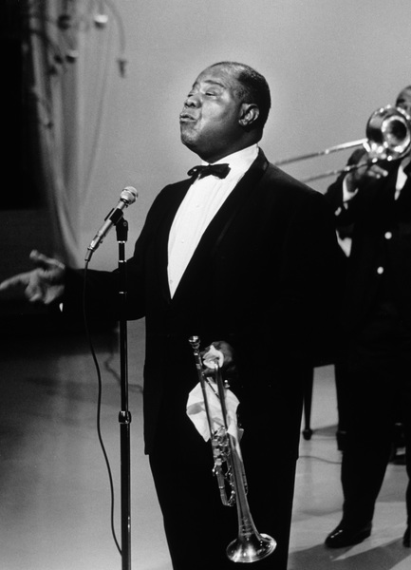
1:13-2:13

Slide 10
1:13-2:13

Slide 11
1:13-2:13
pattern ~ literally, outline or sketch
hupotupōsis ~ under the type or example
NASB ~ standard

Slide 12
1:13-2:13

Slide 13
1:13-2:13
Phygellus ~ “fugitive”
Hermogenes ~ “born of Hermes”
Onesiphorus ~ “one who brings profit or joy”
refreshed ~ anapsuchō
– to refresh the soul
ana ~ re-, again
ana ~ re-, again
psuchō ~ verb form of psuchē (soul)
psuchō ~ verb form of psuchē (soul)

Slide 14
1:13-2:13

Slide 15
1:13-2:13
parathēkē
1:12 ~ committed ~ parathēkē (noun)
ESV ~ I am convinced that he is able to guard until that Day what has been entrusted to me.”
What God had entrusted to Paul
1:14 ~ committed ~ parakatathēkē (noun)
That good thing which was committed to you, keep by the Holy Spirit who dwells in us.
What Paul had entrusted to Timothy
parathēkē
2:2 ~ commit ~ paratithēmi (verb form of parathēkē)
What Timothy would entrust to others

Slide 16
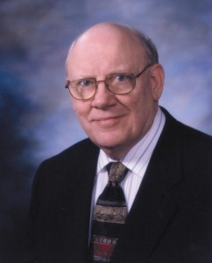
1:13-2:13
Warren Wiersbe ~ “God has deposited with His people the truth of the Word of God. It is our responsibility to guard this treasure and pass it on to others. The task of the local church is not to preserve the truth, as in a museum; but to live it and to teach it to the generations to come.”
Warren Wiersbe
b. 1926

Slide 17
1:13-2:13

Slide 18
1:13-2:13
engaged in warfare ~ strateuomai – strategy

Slide 19
1:13-2:13

Slide 20
1:13-2:13
competes in athletics ~ athleō (verb) “athleticizes”
crowned ~ verb form of stephanos

Slide 21
1:13-2:13

Slide 22
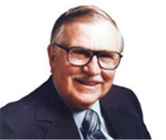
1:13-2:13
J. Vernon McGee ~ “The only exercise some Christians get is jumping to conclusions, running down their friends, side-stepping responsibility and pushing their luck.”
J. Vernon McGee
(1904-1988)

Slide 23
1:13-2:13

Slide 24
1:13-2:13
preparation
The soldier obeys the sergeant (v. 4)
priorities
The athlete obeys the rules (v. 5)
The farmer eats the fruit (v. 6)
perseverance

Slide 25
1:13-2:13

Slide 26
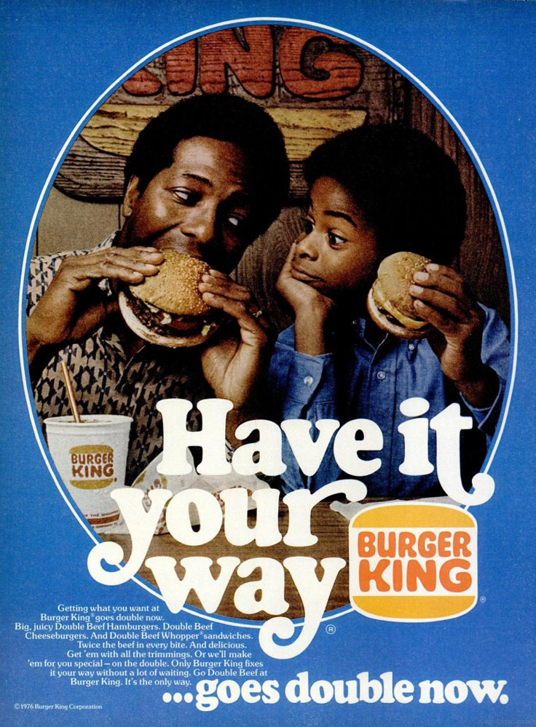
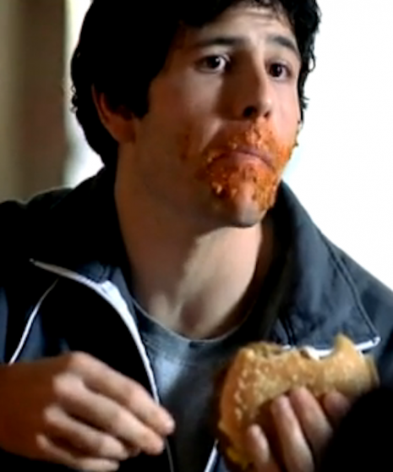
1:13-2:13
If it doesn’t get all over the place,
it doesn’t belong in your face

Slide 27
1:13-2:13

Slide 28
1:13-2:13
Remember
that
Jesus Christ …
ESV, NIV, NASB

Slide 29
1:13-2:13

Slide 30
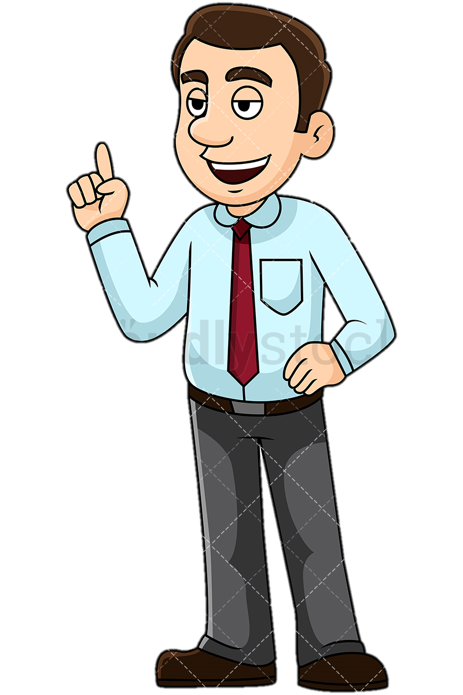
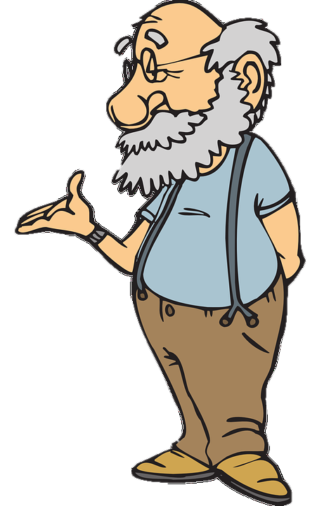
1:13-2:13
endure ~ hupomenō
Aren’t you afraid
you might slip through
His fingers?
How can I?
Literally, to remain under
I am one of His fingers!
Not suffer, as in KJV

Slide 31
1:13-2:13

